Slide 1


AI for Sustainable Agriculture
This document outlines a pioneering project leveraging Artificial Intelligence to address food insecurity, particularly in Sub-Saharan Africa. By predicting crop yields through machine learning models and integrating various environmental factors, the initiative provides critical data-driven insights for farmers and policymakers, contributing significantly to Sustainable Development Goal 2: Zero Hunger.
aj
by afuyo jefther

Slide 2

Project Overview
This project utilizes advanced machine learning techniques to forecast crop yields. The core objective is to empower agricultural stakeholders with predictive insights derived from crucial environmental data points, including rainfall patterns, temperature fluctuations, and the quantity of fertilizer used. By transforming raw environmental data into actionable intelligence, the solution aims to foster sustainable agricultural practices, enhance food security, and optimize resource allocation, ultimately contributing to a more resilient food system.

Slide 3

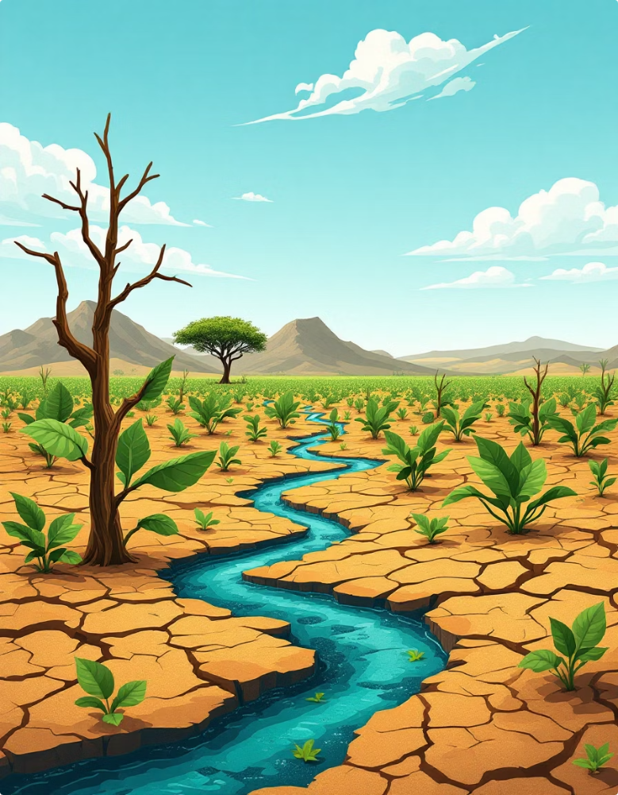
Problem Statement
Sub-Saharan Africa faces significant challenges in achieving food security, primarily due to highly inconsistent crop yields, the accelerating impacts of climate change, and a critical lack of data-driven decision-making tools in the agricultural sector. These factors lead to unpredictable harvests, food shortages, and economic instability for farming communities. This project directly confronts these issues by developing and deploying an AI-powered predictive model designed to support more efficient food production and strategic agricultural planning, mitigating the risks associated with environmental variability and data scarcity.

Slide 4

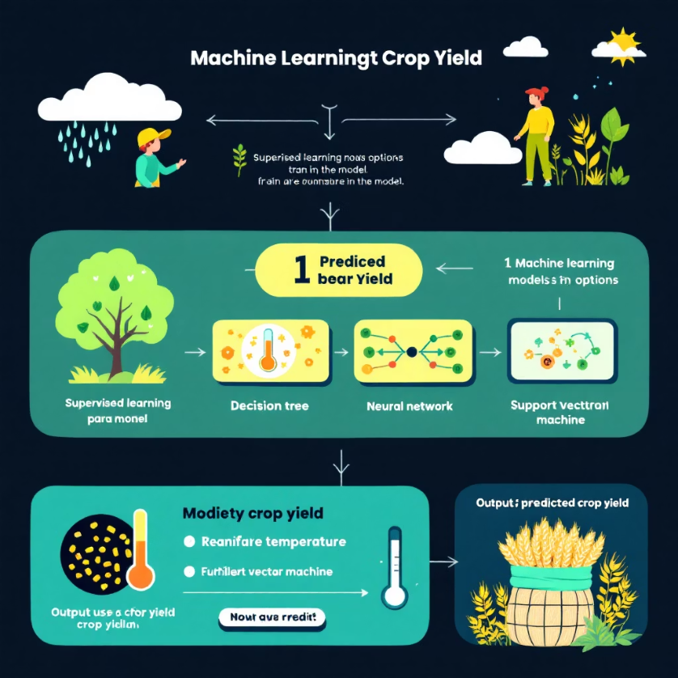
Predictive Modeling for Agriculture
This project uses supervised learning to develop predictive models for crop yields. Random Forest and Linear Regression were chosen for their suitability in agricultural applications.
Methodology
The supervised learning framework trains models using historical data to predict future crop yields (kg/ha). Key inputs are rainfall, temperature, and fertilizer use, all crucial for agricultural productivity.
Project Context
This work is part of a larger initiative using AI to advance sustainable agriculture. Details on the project overview, problem, dataset, model evaluation, and more are in accompanying cards.

Slide 5

Dataset
The predictive models were trained using a comprehensive dataset designed to reflect real-world agricultural conditions. The data was meticulously compiled from reputable sources, primarily drawing from the World Bank and UN SDG Open Data initiatives, ensuring its relevance and accuracy for sustainable development goals. While the dataset encompasses a global scope, a particular emphasis was placed on including detailed agricultural data from Kenya, allowing for localized insights and targeted solutions for the region.
The dataset includes the following critical fields:
Crop Name: Identifies the specific type of crop being cultivated (e.g., maize, wheat, rice).
Region: Specifies the geographical area of cultivation.
Yield: The actual crop output (in kilograms per hectare).
Rainfall: Recorded precipitation levels (in millimeters).
Temperature: Average temperature readings (in degrees Celsius).
Fertilizer Use: Quantity of fertilizer applied (in kilograms).

Slide 6

Model Evaluation
To ascertain the efficacy of the machine learning models, a thorough evaluation was conducted using standard performance metrics. The results clearly indicate the superior performance of the Random Forest model over Linear Regression for this specific application.
Random Forest
Linear Regression
Mean Absolute Error (MAE): 2.13
Mean Absolute Error (MAE): 4.32
Mean Squared Error (MSE): 7.54
Mean Squared Error (MSE): 19.87
R² Score: 0.91
R² Score: 0.68
The Random Forest model significantly outperforms Linear Regression across all key metrics. Its lower MAE and MSE values indicate more accurate predictions with less error, while the higher R² score suggests that 91% of the variance in crop yield can be explained by the model's features, making it a highly reliable tool for agricultural forecasting.

Slide 7



Stretch Goals Achieved
Beyond the core objectives, several ambitious stretch goals were successfully accomplished, significantly enhancing the project's utility and practical application:
Integrated Real-Time Weather Data
Deployed Interactive Web Application
Compared Multiple ML Models
Successfully incorporated the OpenWeatherMap API to fetch real-time weather information. This integration allows the predictive model to update its forecasts with the most current environmental conditions, significantly improving accuracy and relevance for dynamic agricultural planning.
Developed and deployed an intuitive web application using Streamlit. This interactive platform provides a user-friendly interface for farmers and policymakers to input parameters, visualize predictions, and gain actionable insights without requiring technical expertise.
Rigorously compared the performance of two distinct machine learning models (Random Forest and Linear Regression). This comparative analysis ensured that the most optimized and robust model was selected for yield prediction, guaranteeing higher reliability and better decision-making support.

Slide 8

Ethical & Social Reflection
The development and deployment of this AI solution for agriculture have been guided by a strong commitment to ethical considerations and positive social impact. We recognize the profound responsibility that comes with introducing technology into vital sectors like food production.
Bias Consideration
Social Impact
Sustainability
While striving for comprehensive data, it's acknowledged that the dataset may not perfectly represent the vast diversity of farming regions and practices globally. Efforts were made to include data from varied sources, but inherent biases in data collection could lead to models performing sub-optimally in underrepresented areas. Future work will focus on expanding dataset diversity.
This project directly aims to promote more equitable food distribution by enabling more efficient and predictable food production. By providing advanced AI tools, farmers, particularly those in underserved regions, gain access to critical insights that can enhance their yields, reduce post-harvest losses, and improve their livelihoods, thereby fostering greater food security and resilience.
The predictive capabilities of the AI model encourage smarter farming practices. By optimizing inputs like water and fertilizer based on yield predictions, the solution helps reduce waste, conserve natural resources, and minimize the environmental footprint of agriculture. This aligns directly with global sustainability goals, fostering a more environmentally responsible food system.

Slide 9




Demo & Future Enhancements
A functional demonstration of the AI-powered crop yield prediction tool is readily available, showcasing its practical application and intuitive interface. This live application provides a tangible example of the project's capabilities and user experience.
Live Application: The interactive web application is accessible via Streamlit, either on a local machine (localhost) for development purposes or on a deployed platform for broader access. This allows users to engage directly with the model, input various environmental parameters, and observe real-time yield predictions.
Building on this foundation, future enhancements are planned to further expand the tool's capabilities and reach:
Integrate APIs for Agronomic Data
Future iterations will include APIs for more specialized agronomic data, such as soil composition, nutrient levels, and pest incidence, providing a richer dataset for more nuanced predictions.
Add Satellite Image Classification
Incorporating satellite imagery and machine learning for image classification will enable broader field monitoring, crop health assessment, and large-scale yield estimation.
Deploy Globally with User Login Support
To maximize impact, the application will be deployed globally, with robust user login and profile management features to cater to diverse users and ensure data privacy.

Slide 10
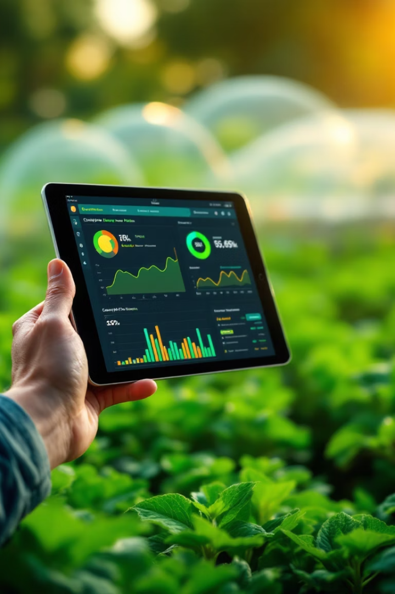
Contact & Credits
For further inquiries, collaborations, or detailed information regarding this project, please feel free to reach out to the project lead:
Name: Jefther Simeon Afuyo
Email: afuyojefther@gmail.com
Phone: +254796090806
GitHub: github.com/Jefther37
The successful execution of this project is a testament to the power of open data, collaborative development, and a shared vision for a more sustainable and food-secure future. We extend our gratitude to the contributors of open-source libraries and data initiatives that made this research possible.

